Slide 1

Customer Wars
Lede, 26 April 2022

Slide 2
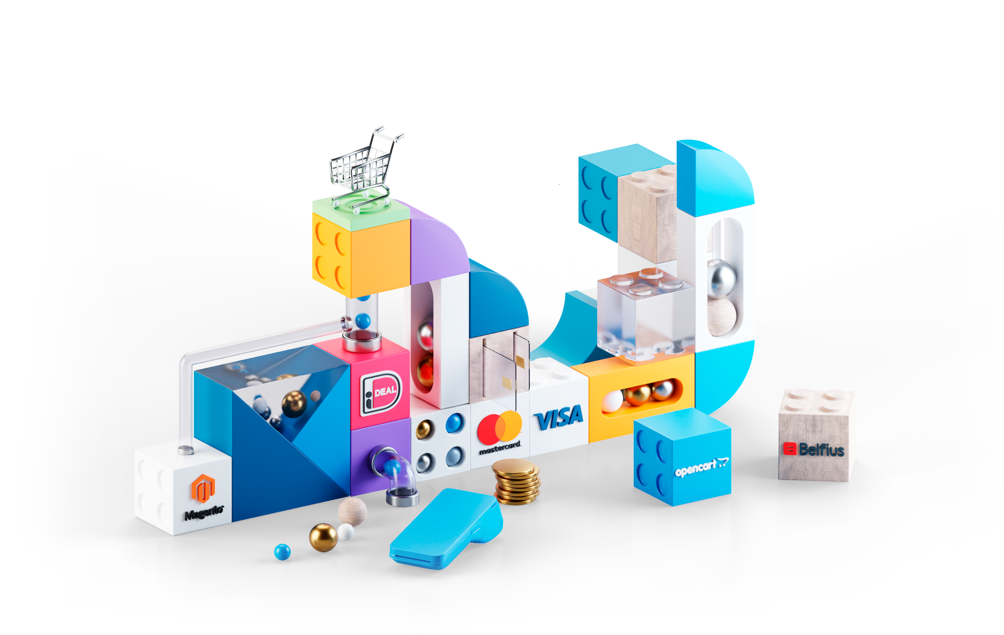

We are MultiSafepay. We are builders.

Slide 3








Building bespoke payments solutions since 1999
20 years of experience in fueling the growth of our clients
Collecting Payment Service Provider
Acquirer & processor for Visa, MasterCard
& Bancontact
International / multilingual team
140+ dedicated employees
In-house support & integration development
17.000+ active merchants
Direct communication with sales, developers, and operations
Full range of solutions to support every kind of merchant

Slide 4

Build an invincible
checkout
Win the “Customer Wars”

Slide 5
Pre - shopping cart
Logos of trust
Contact information
Cross selling
Shopping cart
Avoid distractions
1 step checkout? Or more stepa?
Autocomplete
Cart Summary
Summary shipping details
Shipping / Invoice details
Payment methods
Tokenization
Digital Wallets
Agenda
Post - shopping cart
Keep Cart Alive
‘Thank you’ page
Second chance mail

Slide 6

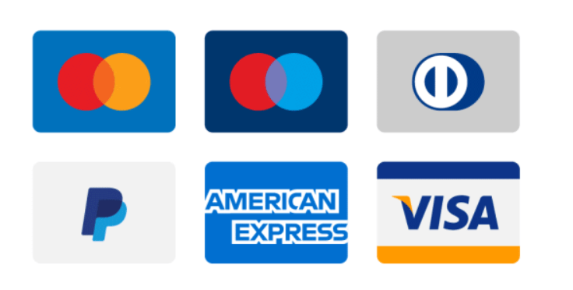






Logos of trust
Reviews
Payment logos
Quality Labels

Slide 7
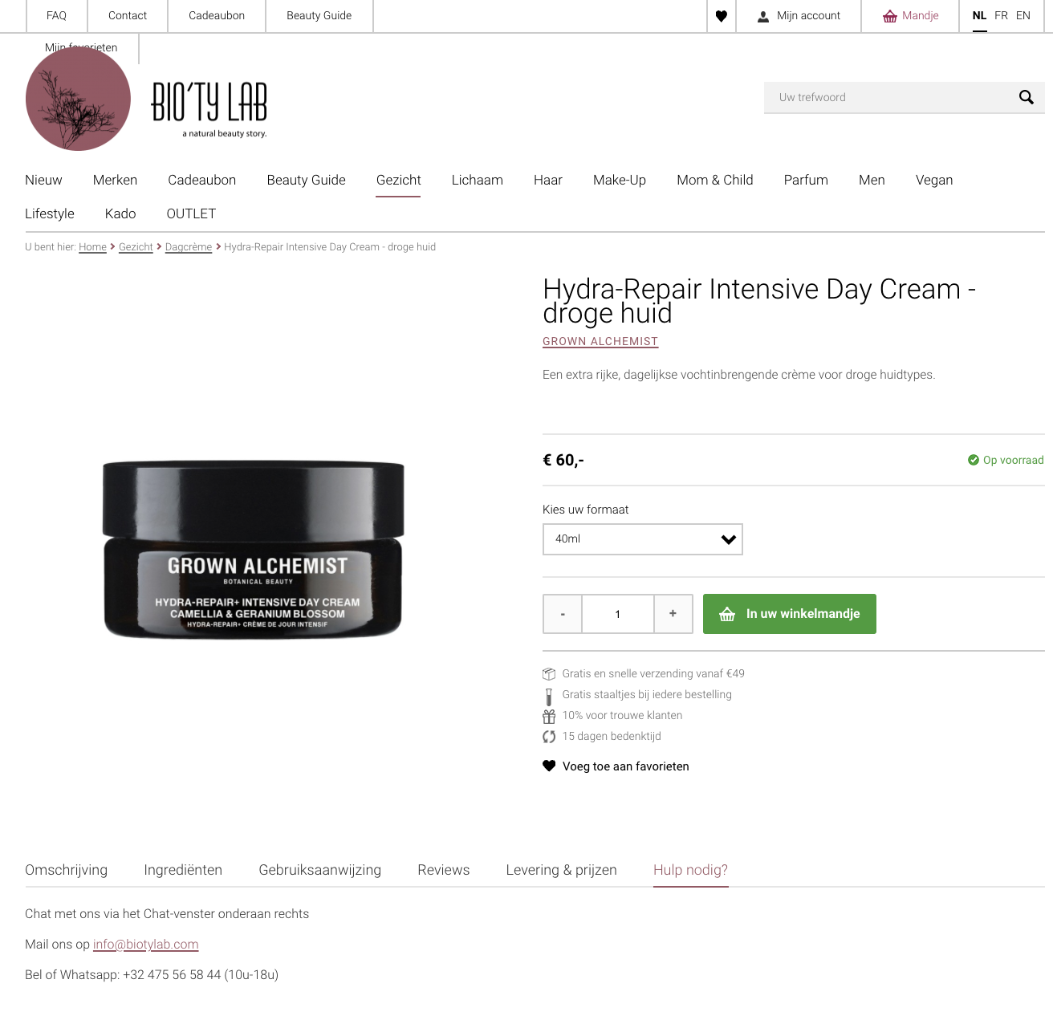
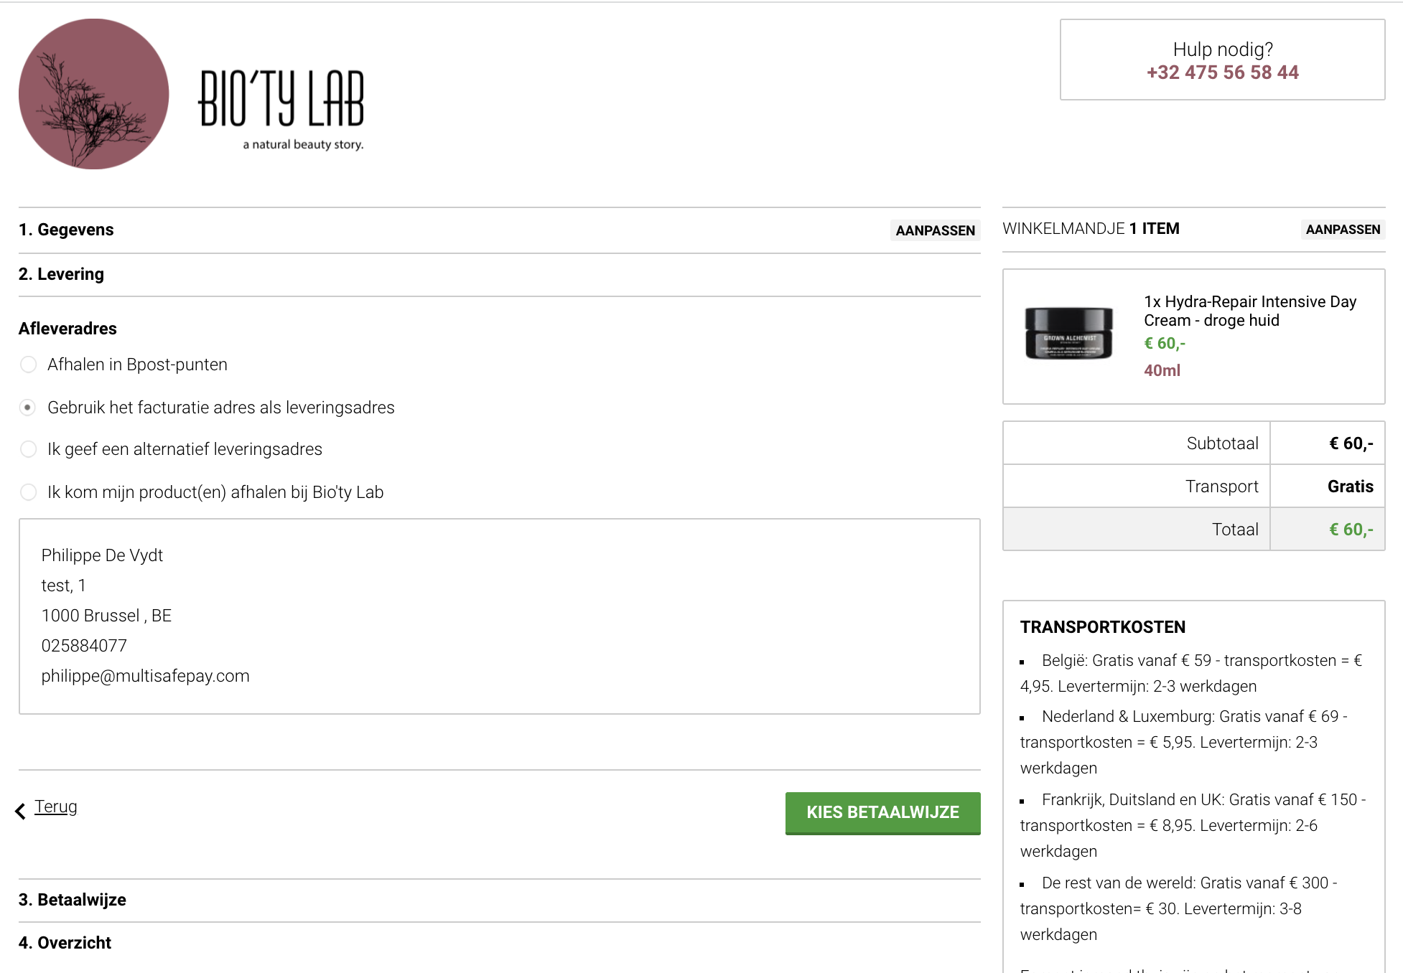
Contact information
Cross selling
Avoid distractions
Avoid distractions

Slide 8
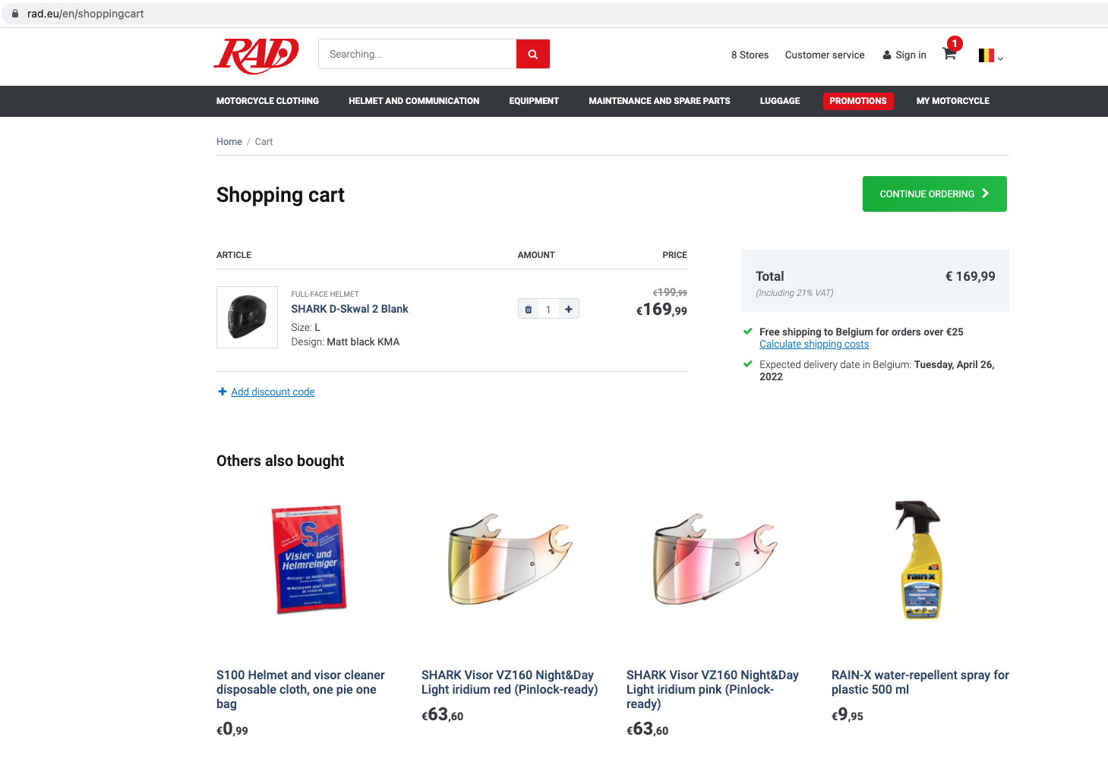
Contact information
Cross selling
Avoid distractions

Slide 9
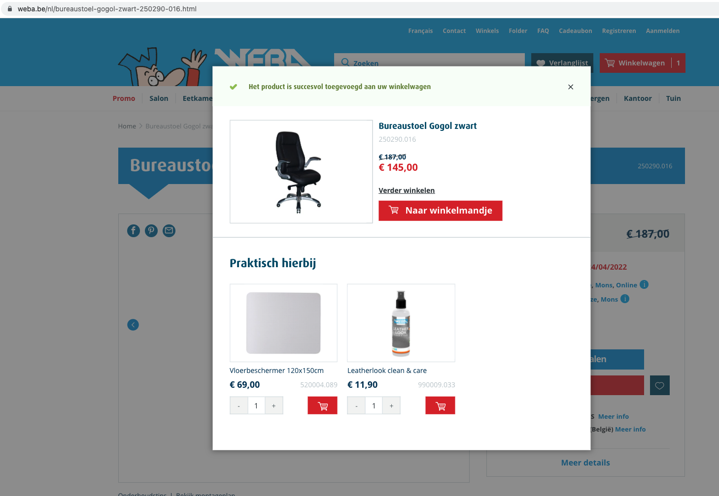
Contact information
Cross selling
Avoid distractions

Slide 10
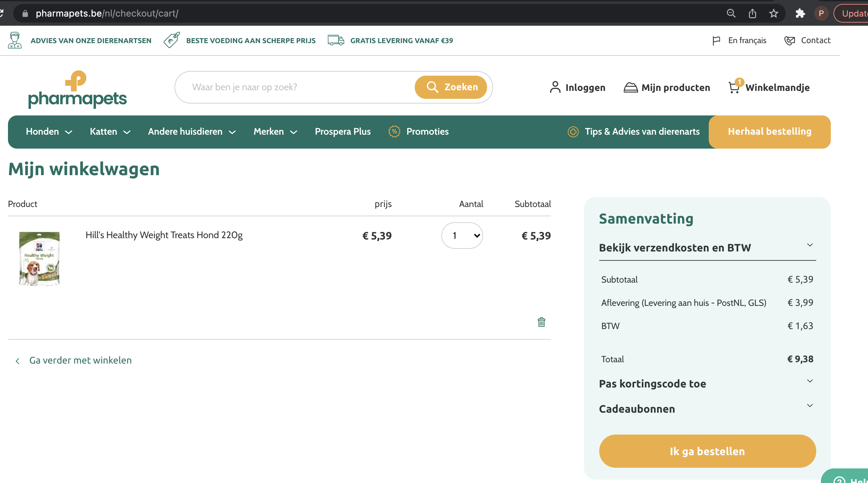
Contact information
Cross selling
Avoid distractions

Slide 11
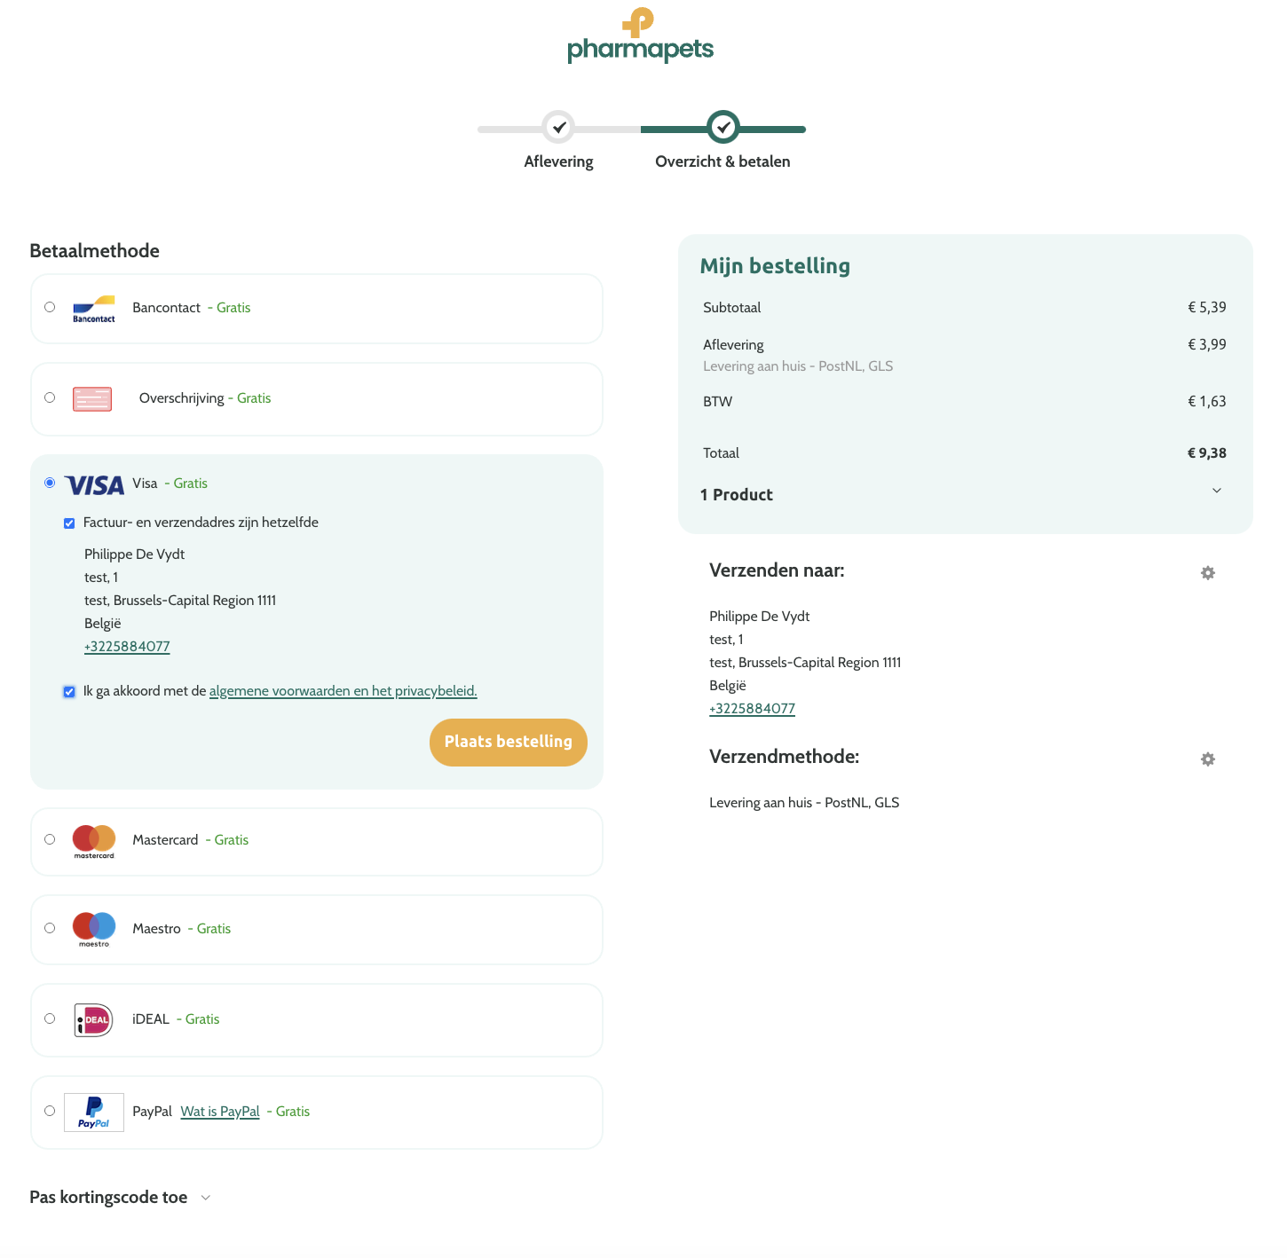
Contact information
Cross selling
Avoid distractions

Slide 12
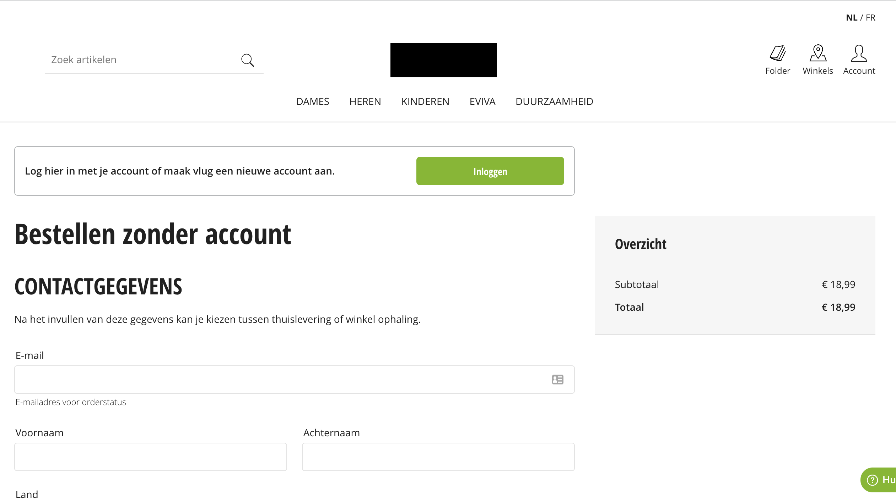
Contact information
Cross selling
Avoid distractions

Slide 13
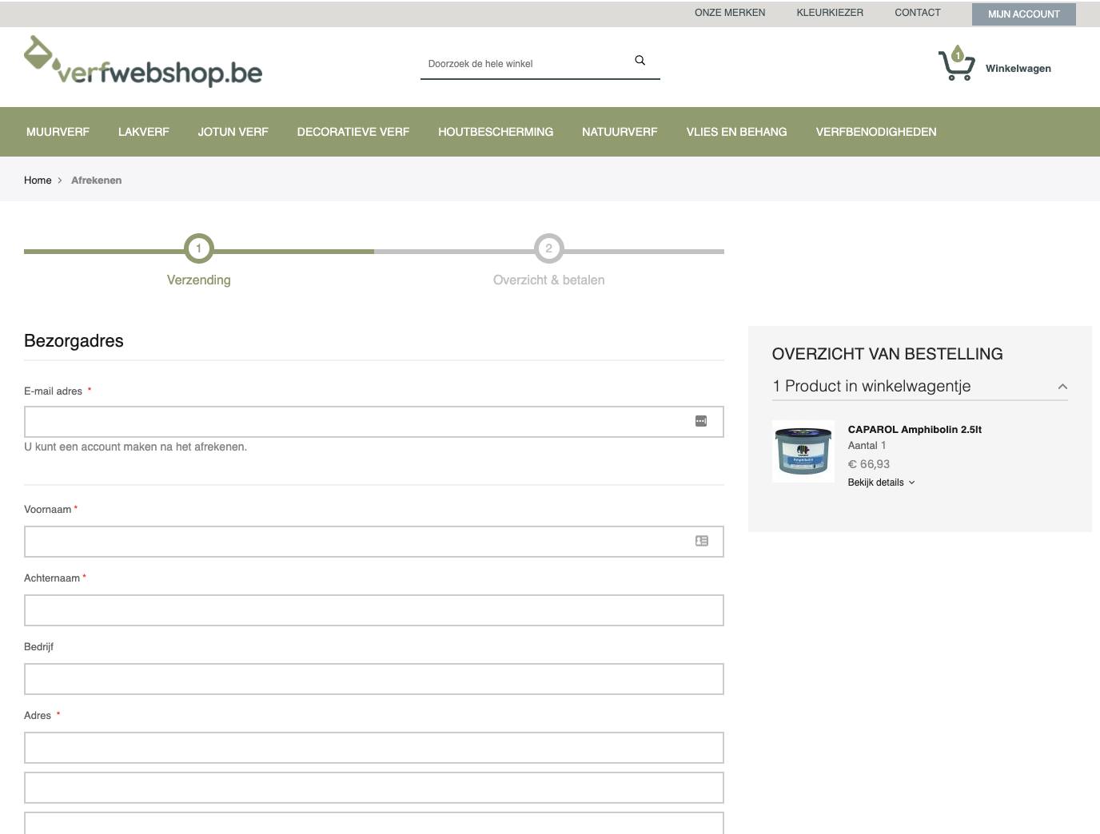
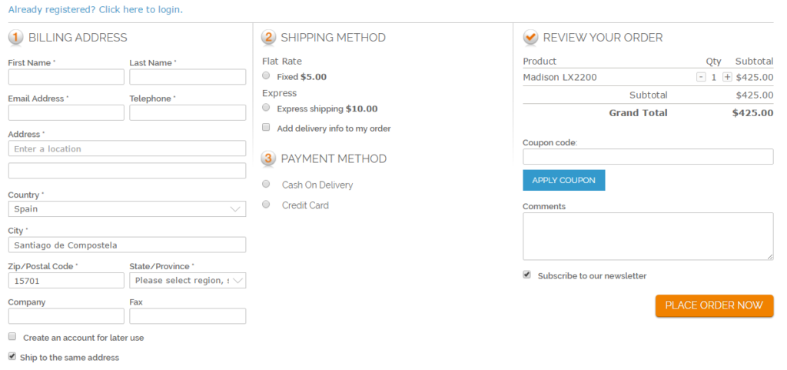
1-step checkout?
Or more?

Slide 14
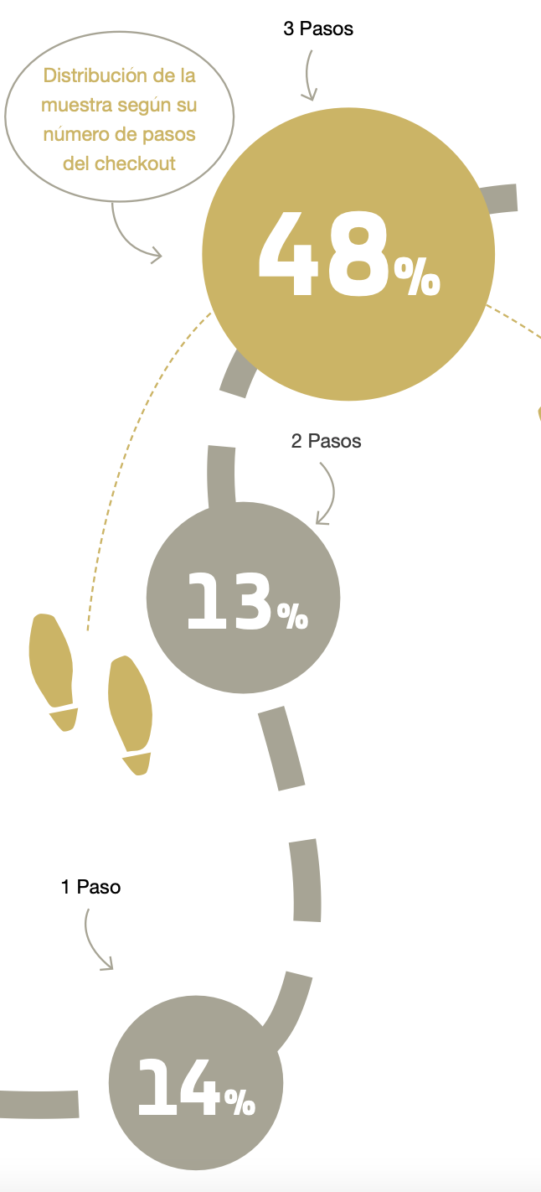
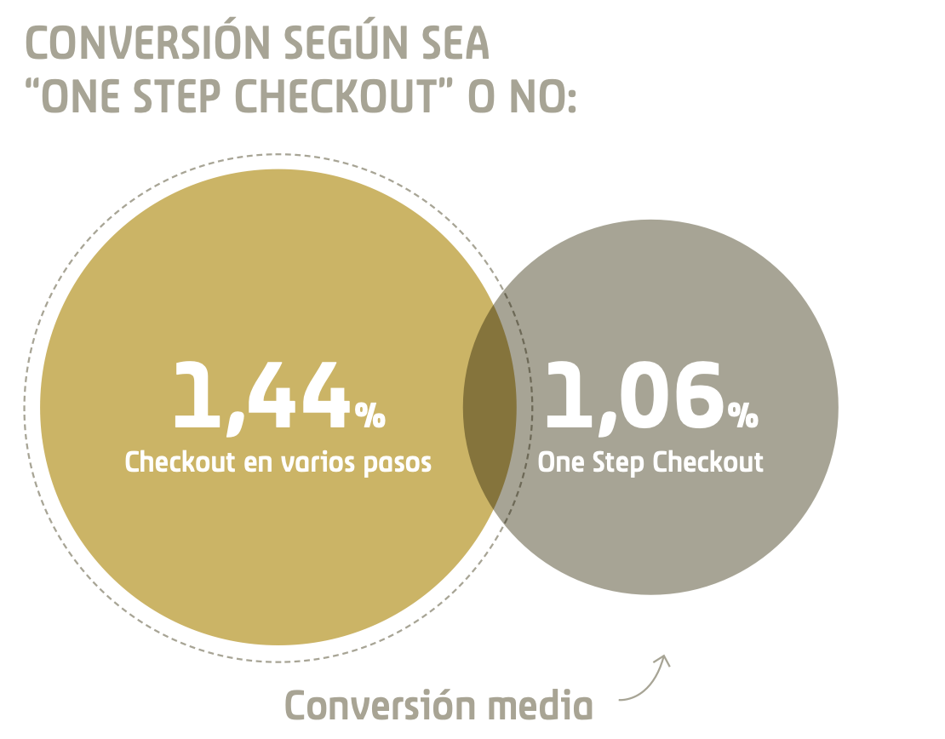
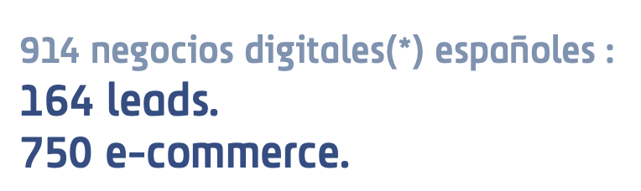
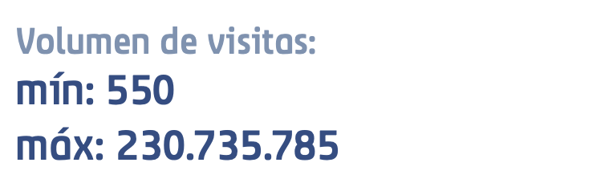
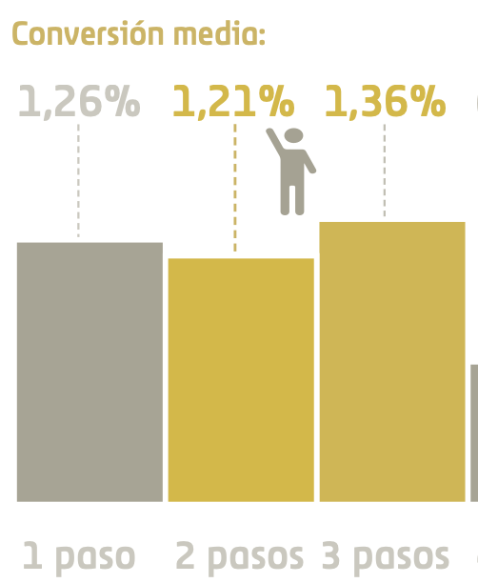
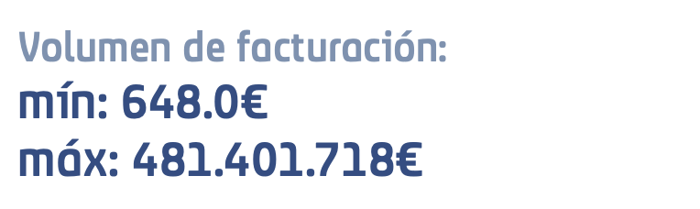
1-step checkout?
Or more?
Source:
Estudio Anual de Conversión en E-Commerce y Negocios Digitales 2021 by Flat 101

Slide 15
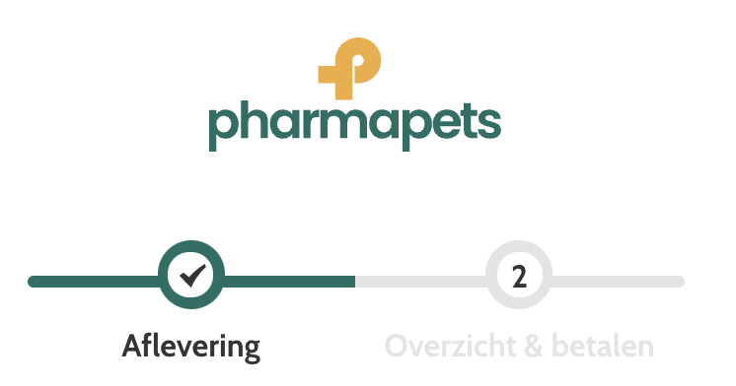
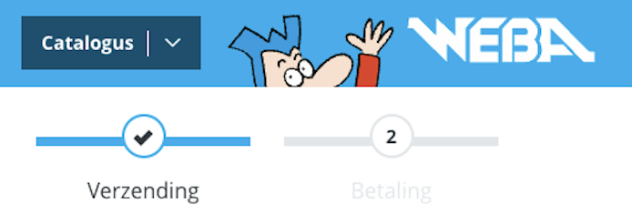
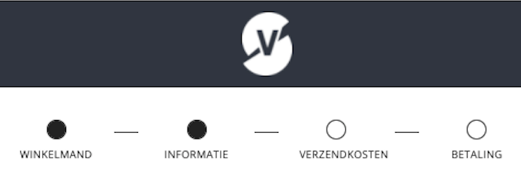
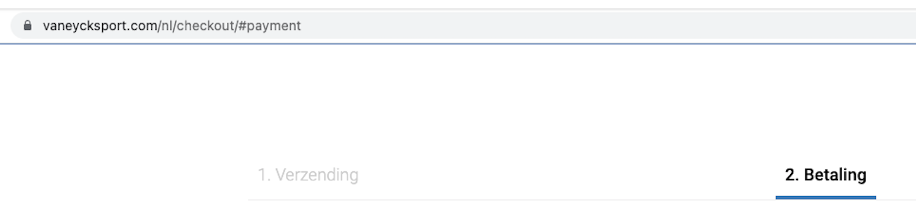
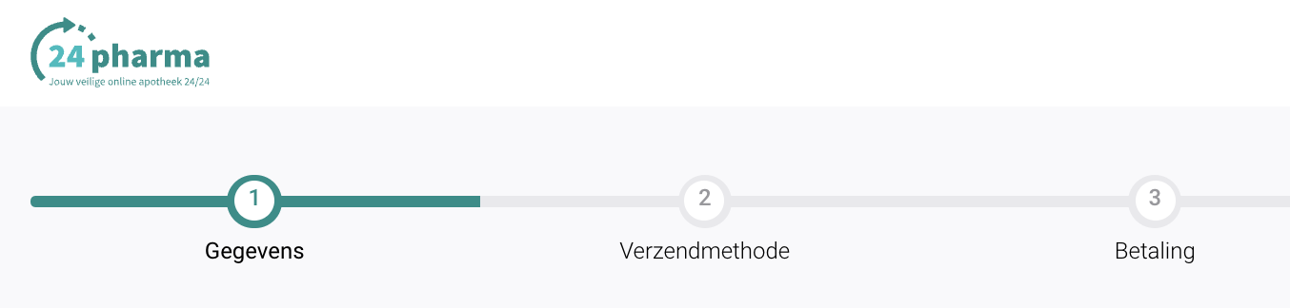
1-step checkout?
Or more?

Slide 16
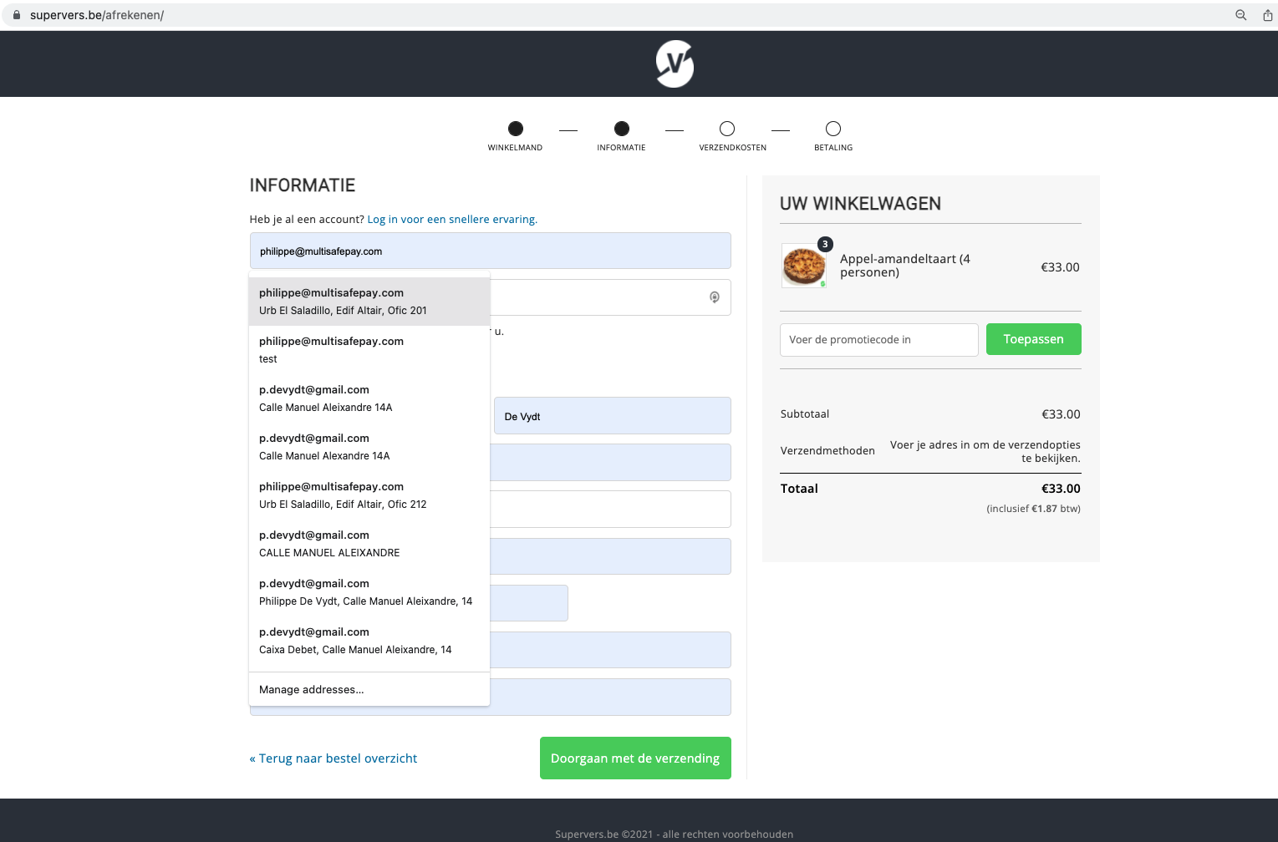
Autocomplete

Slide 17
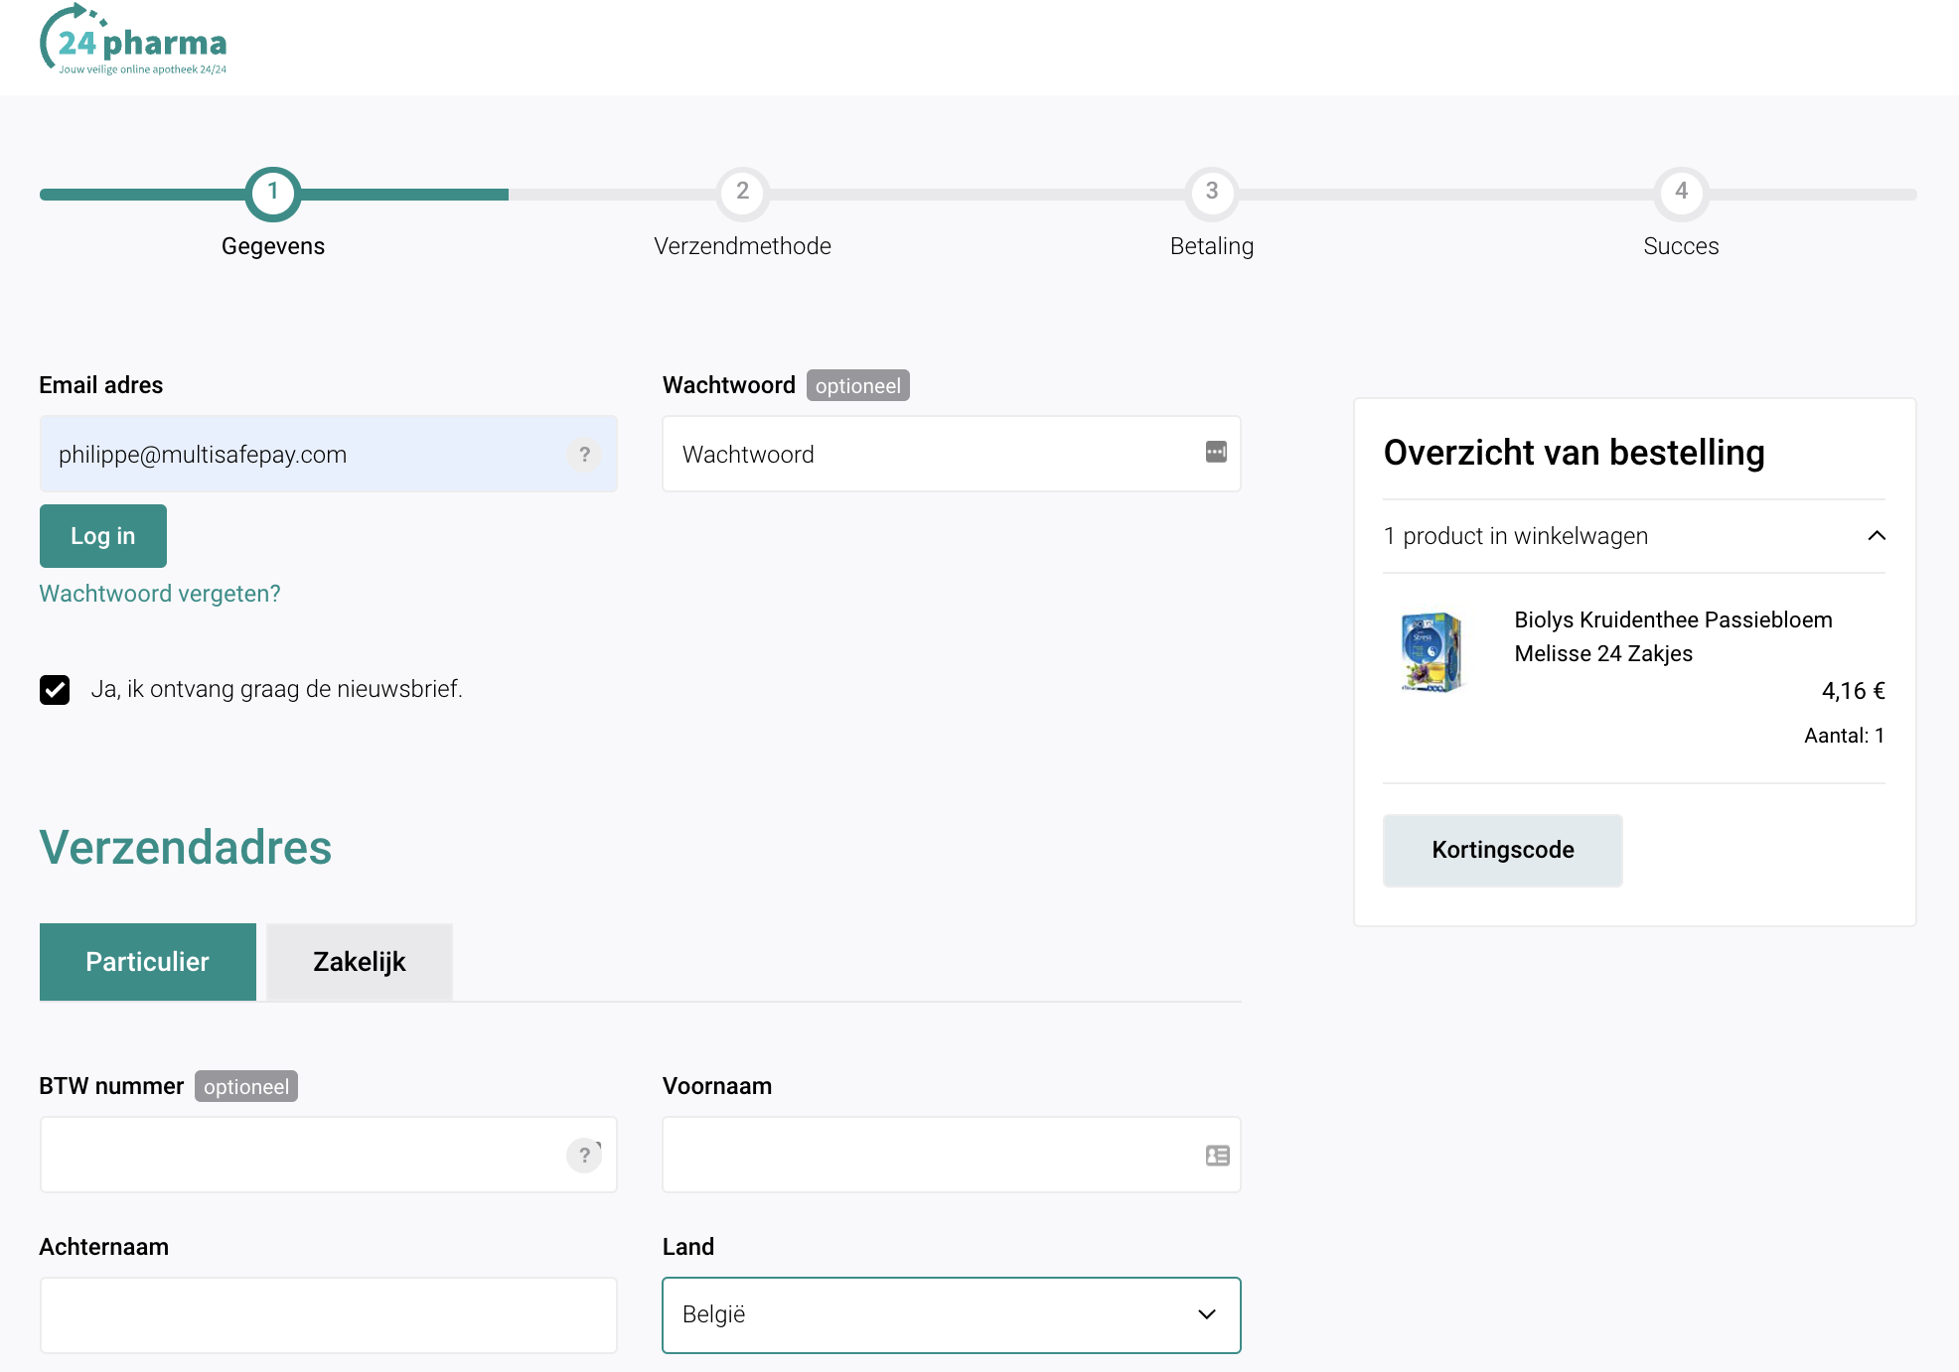
Shopping cart summary

Slide 18
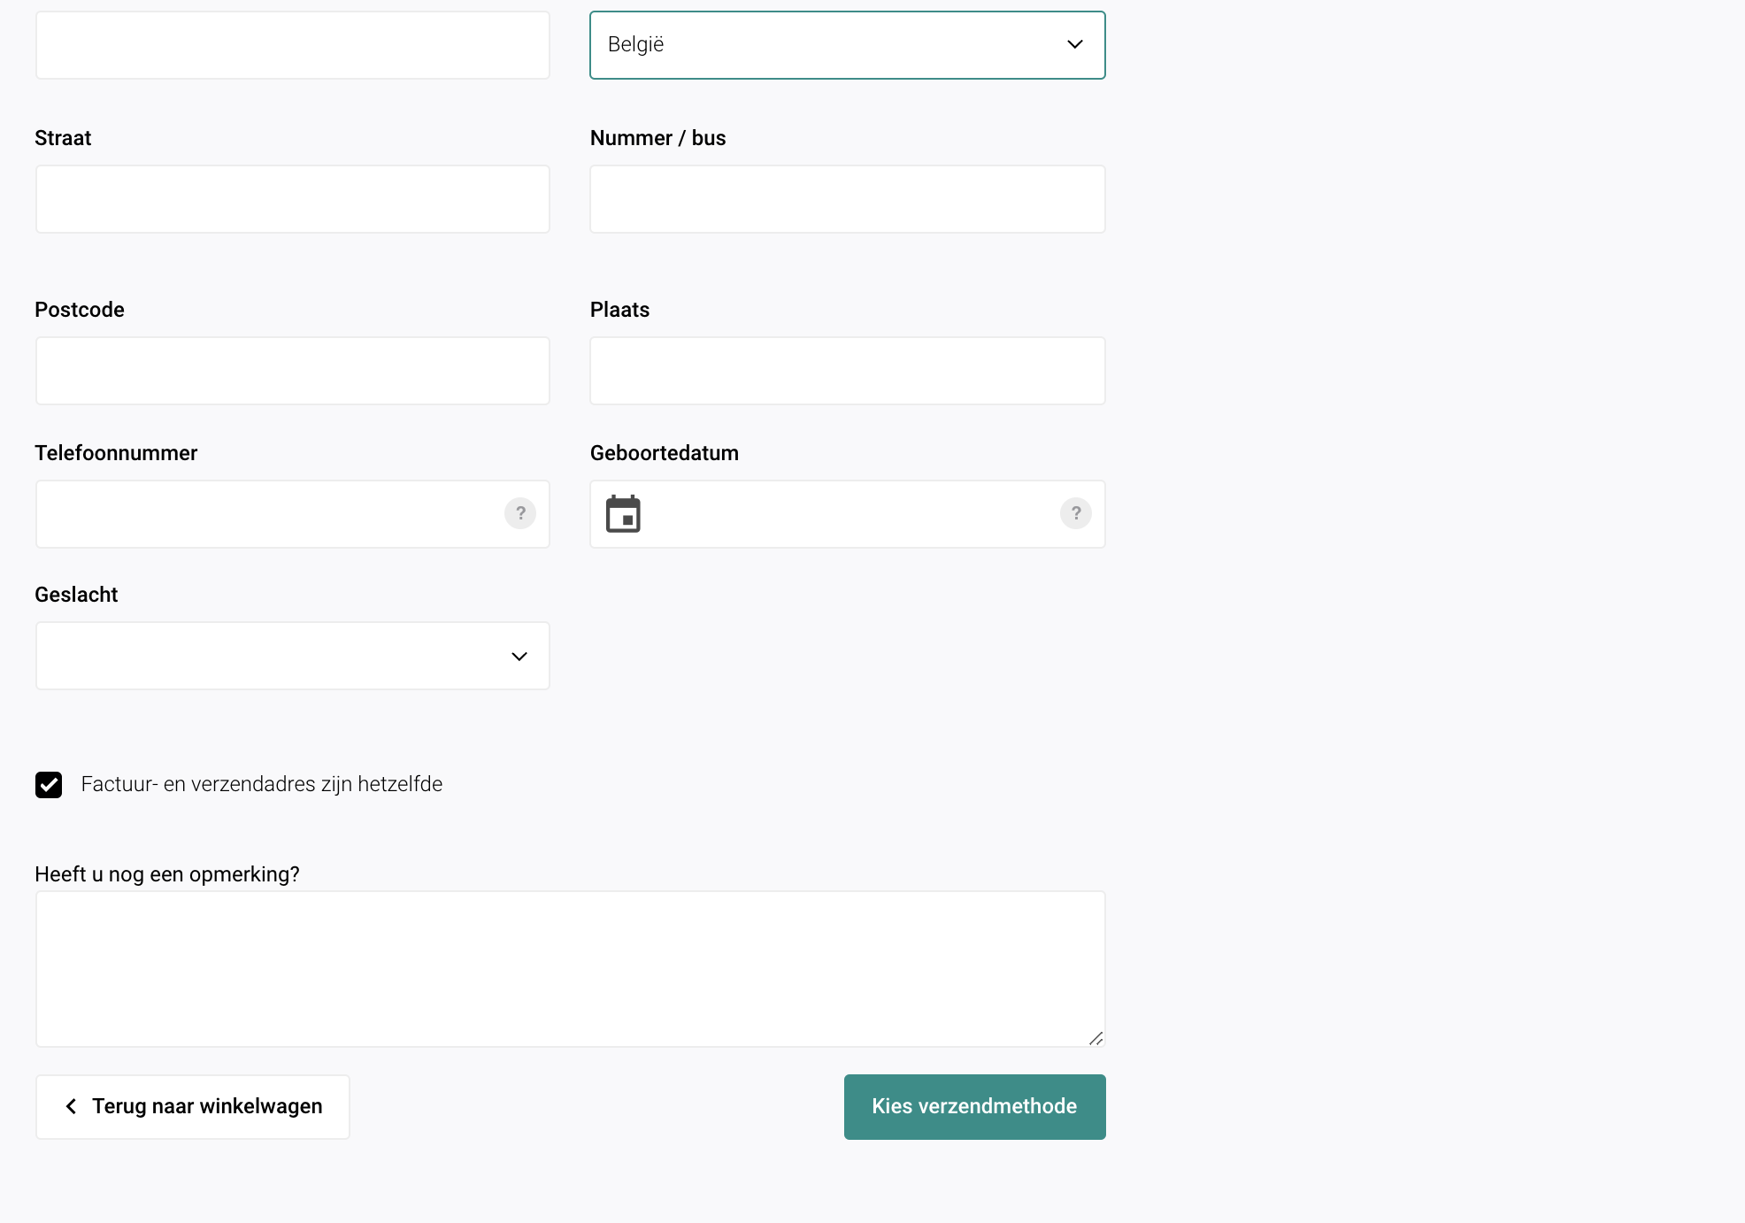
Shipping / Invoice details

Slide 19
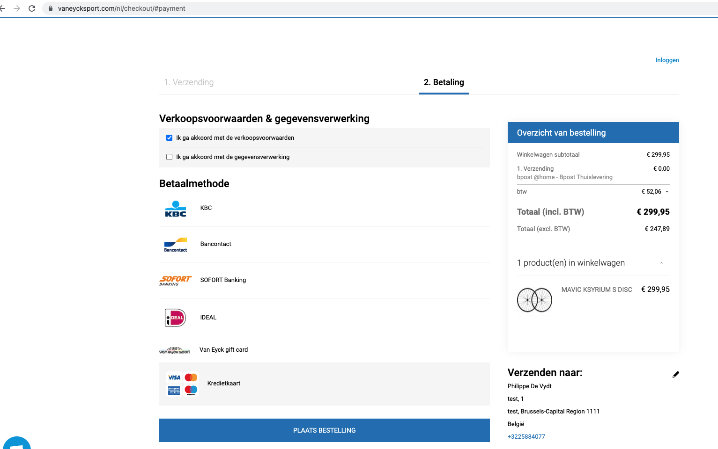
Summary shipping details

Slide 20


Payment methods
The right payment mix for every business type
All the international and local payment methods your customers know and trust

Slide 21
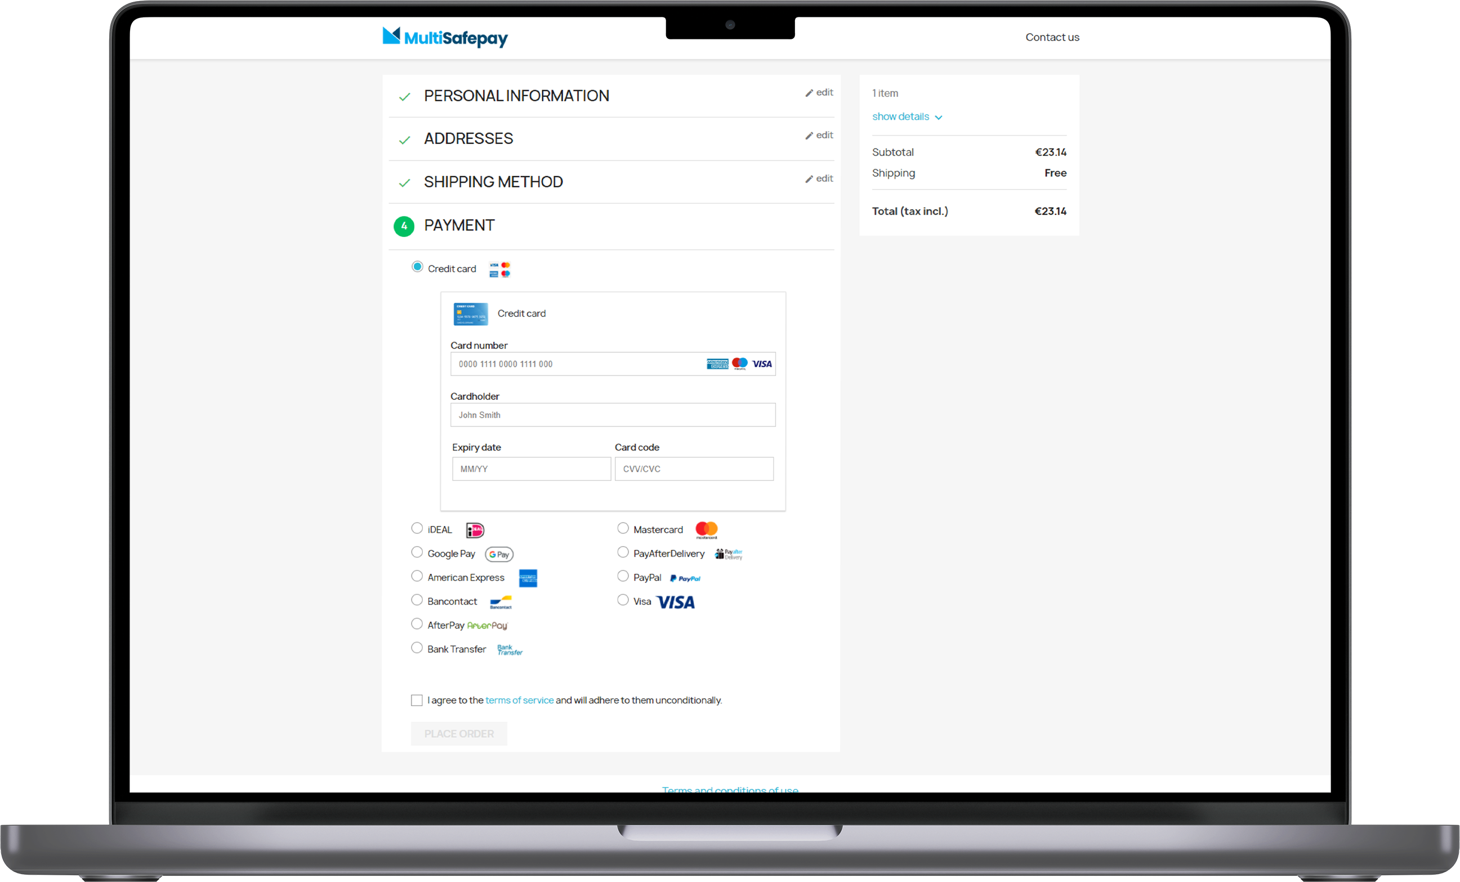

Tokenization

Slide 22


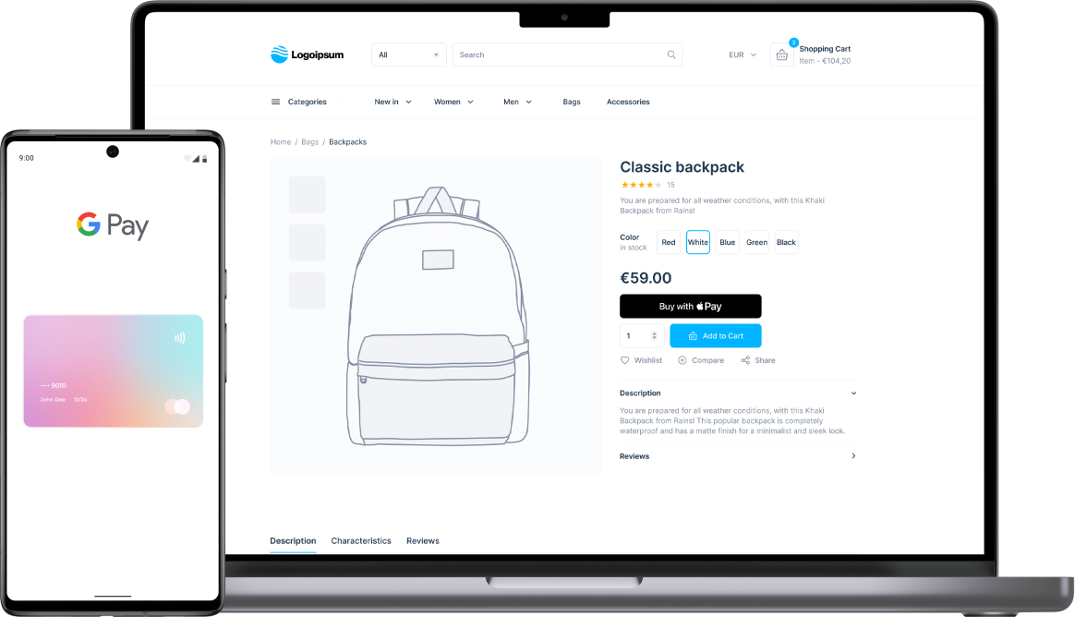




Digital wallets
Apple Pay
PayPal
Google Pay
Bancontact
WIP
WeChat Pay
Advantages
No chargebacks
Fast -> Pay with fingerprint or QR code
Safe for both entrepreneur and customer
Easy -> Higher conversion rate
Realtime transactions

Slide 23

Digital wallets

Slide 24
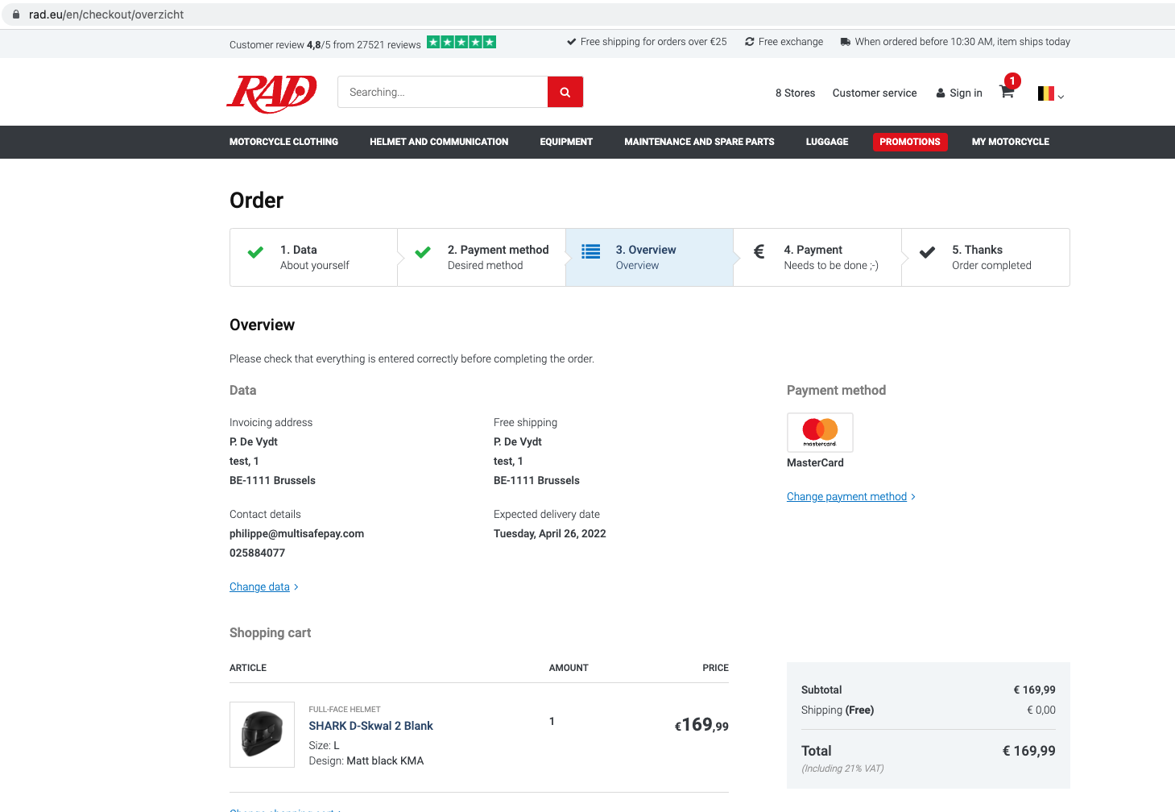
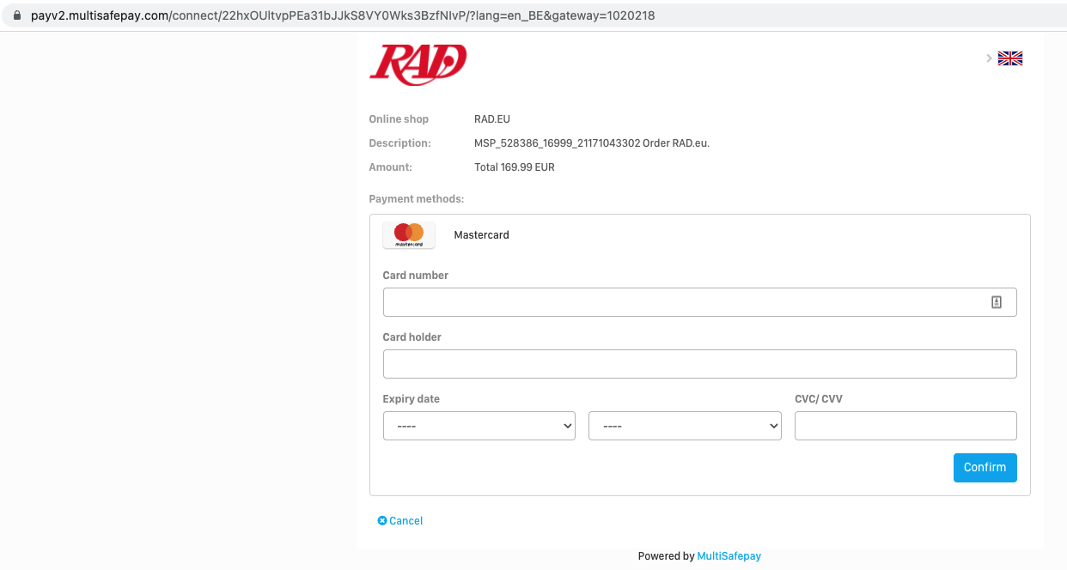
Keep Cart Alive

Slide 25
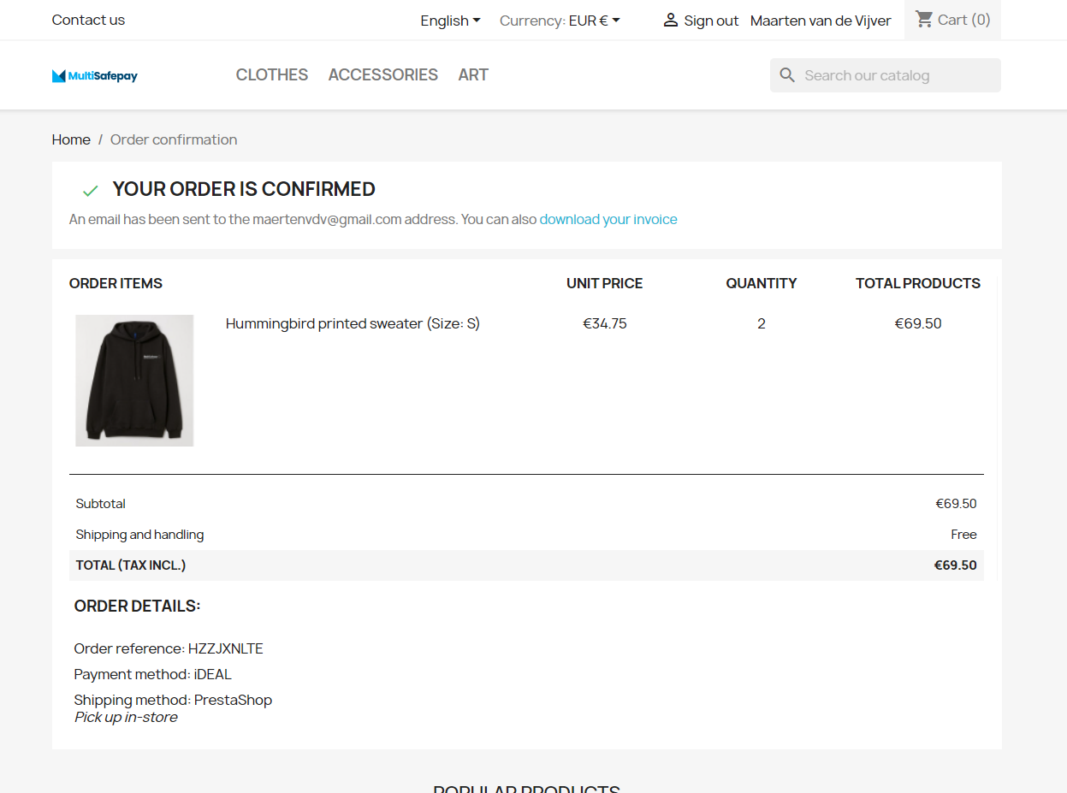
’Thank you’ - page

Slide 26
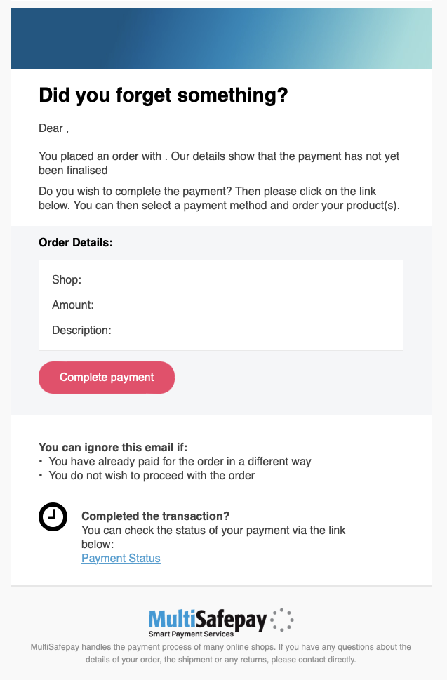

Abandoned payment recovery
Philippe,
70 % abandoned shopping carts
10 % abandoned payments
Recover up till 48%
MultiSafepay
€59,99
Customer wars

Slide 27


Slide 28
Thank you!
Questions?

